Slide 1
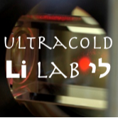
High Amplitude Modulation of the Magnetic Field at RF Frequency
Roy Elbaz, Yaakov Yudkin, Lev Khaykovich
Bar-Ilan University

Slide 2
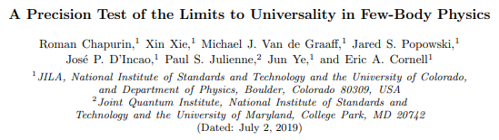
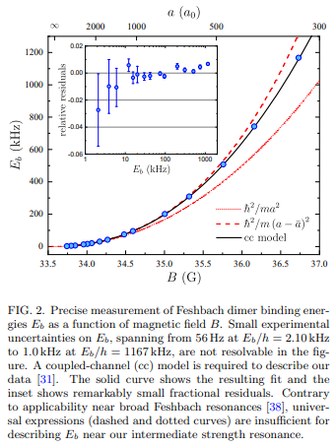
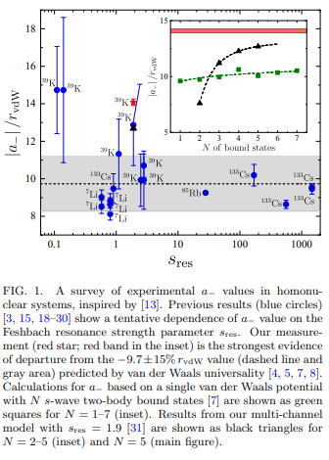
Motivation

Slide 3
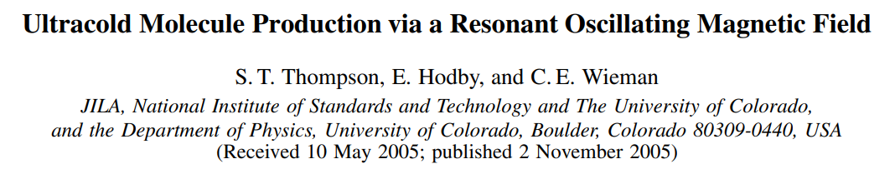
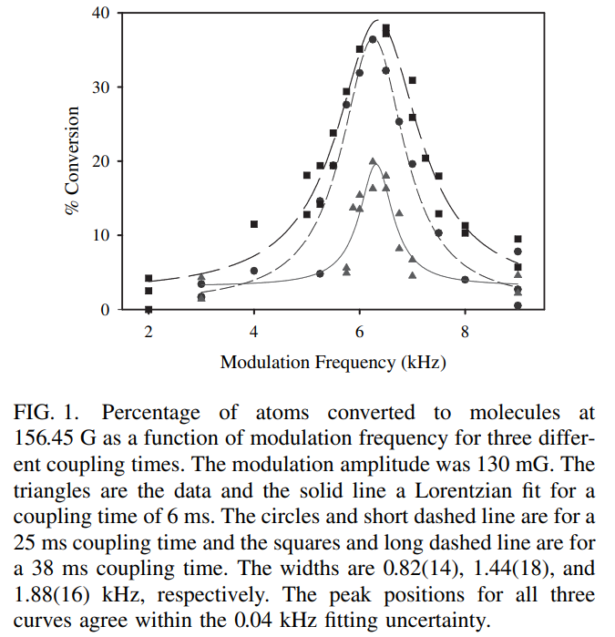




Motivation
RF pulses are often used for molecule production in cold-atoms experiments.
$$E$$
$$Free atoms continuum$$
$$\frac{1}{a_{\left(B\right)}}$$
$$E_{d}$$

Slide 4
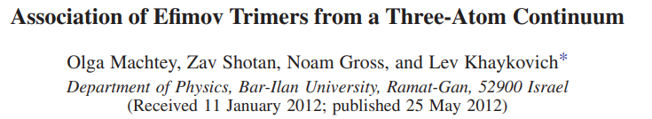
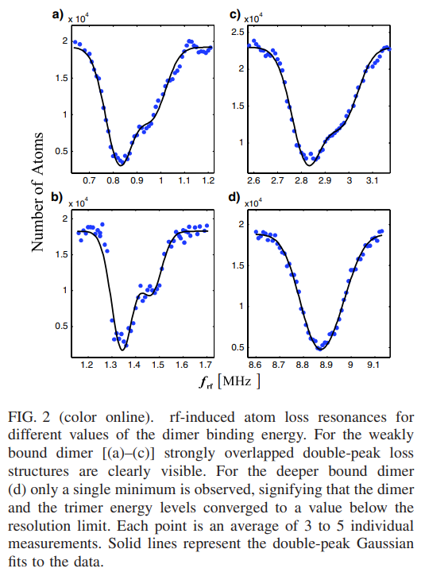
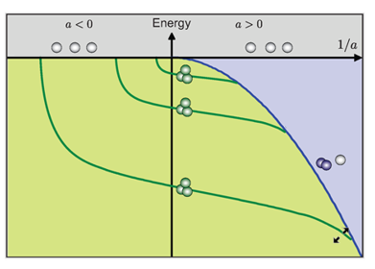
Motivation

Slide 5
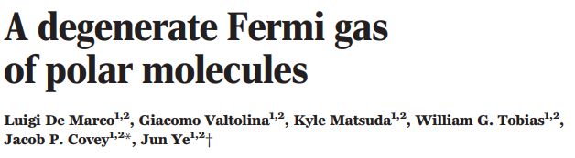
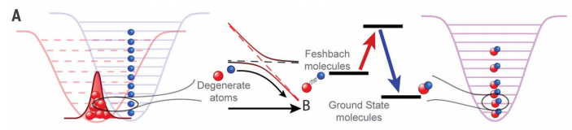




Degenerate Fermi gas (K)
“STIRAP”
BEC (Rb)
$$E$$
$$Free atoms continuum$$
Rb
$$\overline{B}$$
Rb
$$\overline{B}$$
K
$$\frac{1}{a}$$
K
Adiabatically changing the magnetic field
$$E_{dimer}∝\frac{1}{a^{2}}$$

Slide 6
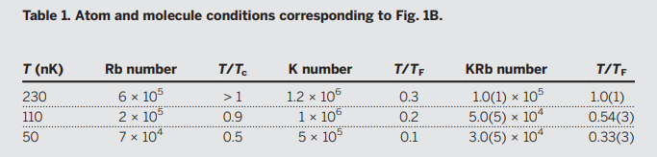

Degenerate Fermi gas (K)
“STIRAP”
BEC (Rb)
“STIRAP” process has >90% efficiency
Conversion efficiency of $\sim 15$% for thermal gas

Slide 7
So where is the problem?
Wanted attributes:
Large conversion efficiency.
Short coupling time (compared to life-time).
Short coupling time → High modulation amplitude is needed → High current (@ high frequency).
Difficult to accomplish due to the antenna inductance.

Slide 8
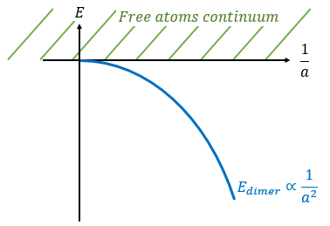
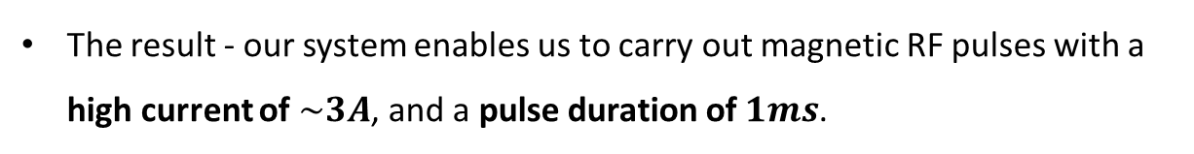
Solution
We added a capacitor and then the RF antenna is the inductor of an LC circuit.
This causes a resonant behavior → all the current that can be provided by the source (VCC) is provided.
The result - our system enables us to carry out magnetic RF pulses with a high current of $\sim 3A$, and a pulse duration of $1ms$.
Limitation - discrete values for the frequency.
We overcome this by varying our DC magnetic field.

Slide 9
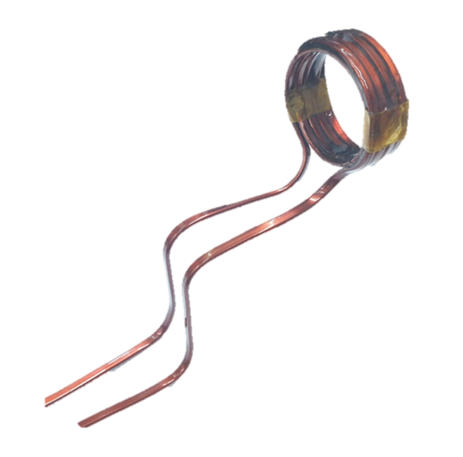
System Description
Our system is composed out of the following elements:
Power supplier (VCC).
Arbitrary function generator (input signal).
Signal amplifier (RF MOSFET driver).
LC circuit (including the RF magnetic pulse generator).
Atoms
Signal Amplifier
C
VCC
Input

Slide 10
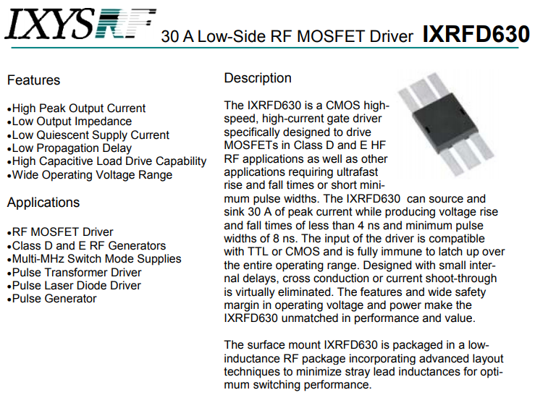

Slide 11
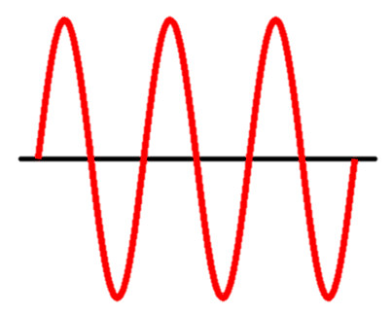

System Operation
A function generator provides a square wave signal @ ~10MHz.
The LC circuit filters out all frequencies but the resonance frequency.
A high current sine wave is provided to the antenna.
VCC provides a constant voltage of 15V (can provide up to 10A).
A MOSFET driver connects the VCC to the output according to the input signal.
Atoms
15V
Signal Apmlifier
C
VCC
Input
$$\sim 100ns$$

Slide 12
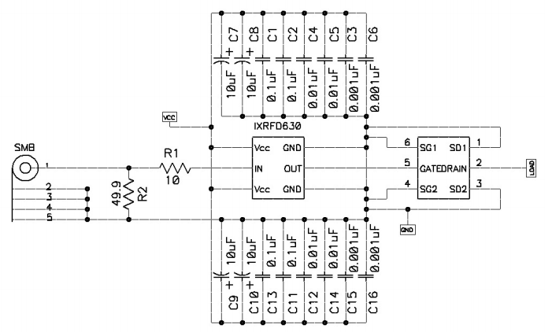
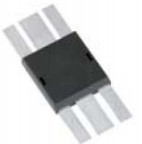
MOSFET Driver Full Circuit

Slide 13
MOSFET Driver Full Circuit
10μF (Tantalum) capacitors for protecting the circuit from rapid spikes in the VCC.
Small capacitors for frequency filtering.

Slide 14
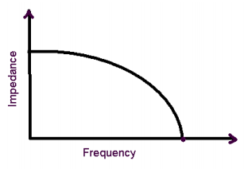
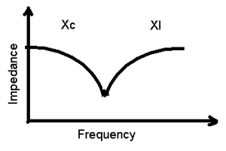
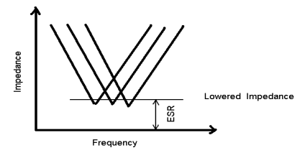
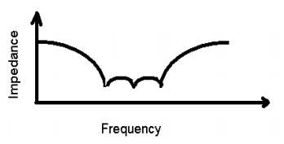


BW Filter
$$f_{c}=\frac{1}{2πRC}$$
Ideal capacitor frequency response
Capacitor frequency response due to self inductance
Filtered out
Overlapping impedance curves
Broadband impedance lowered
!
$$C_{tot}≠C_{1}+C_{2}+C_{3}+…$$

Slide 15
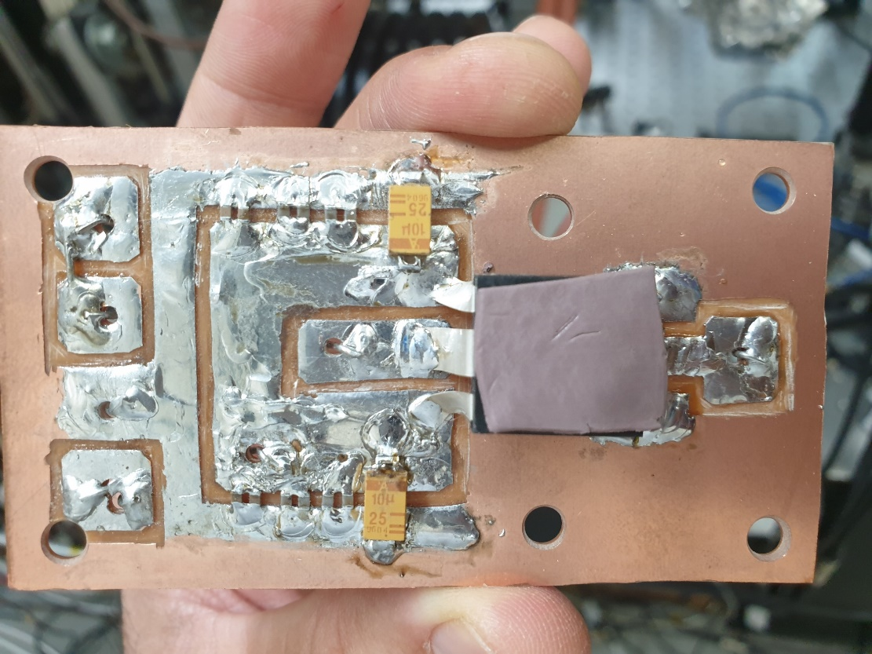
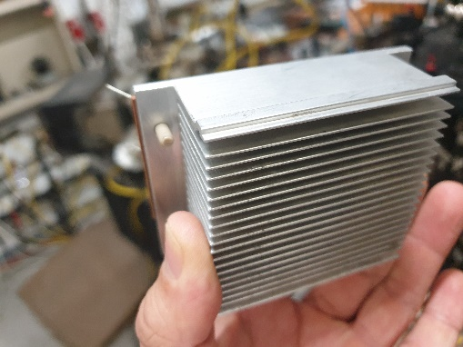
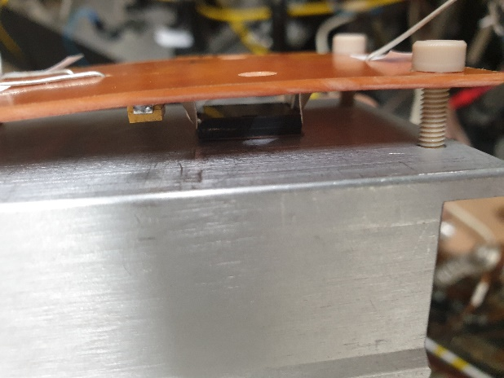
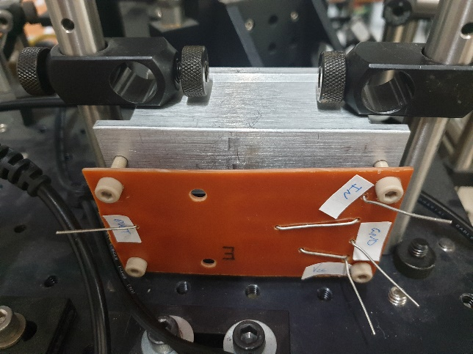
MOSFET Driver Full Circuit
VCC
In
Out
Ground
Heat sink

Slide 16
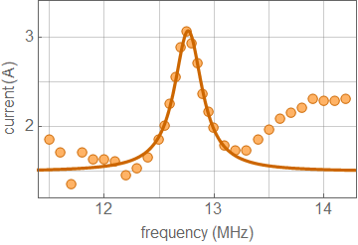
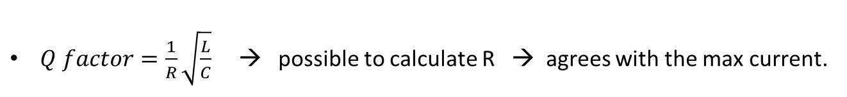
Performance
$Q factor=\frac{f_{0}}{Δf}≅40$
$Q factor=\frac{1}{R}\sqrt{\frac{L}{C}}$ → possible to calculate R → agrees with the max current.
Higher frequencies does not go through the antenna.

Slide 17
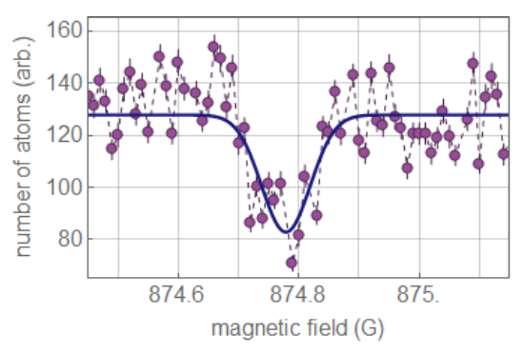
Performance
With a 1ms pulse @12.8MHz we were able to have a ~35% conversion of atoms into molecules (same efficiency as the 38ms pulse in the PRL 95, 190404 (2005) ).
The molecules are still in the trap!
With a 2ms pulse we get 50% conversion (upper bound for our system’s density)

Slide 18



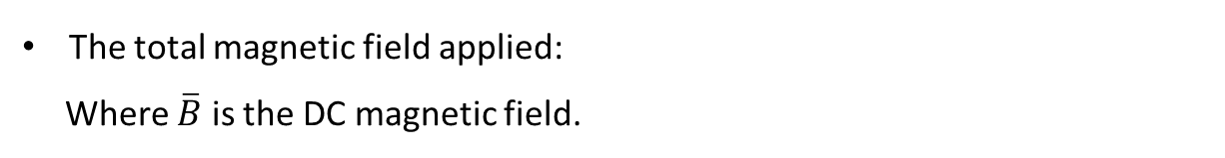


Second Order Effects
The total magnetic field applied:
Where $\overline{B}$ is the DC magnetic field.
$\overline{B}$ changes the scattering length and therefor sets the point in which we work.
An RF photon stimulates the atoms to form dimers.
$$E$$
$$Free atoms continuum$$
$$\overline{B}$$
$$\frac{1}{a}$$
$$E_{d}\sim \frac{1}{a^{2}}$$

Slide 19

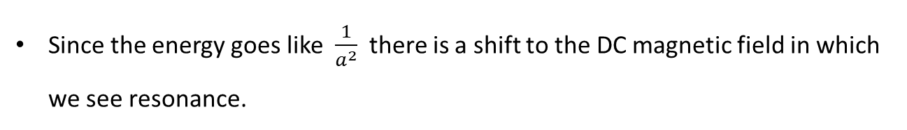
Second Order Effects
The modulation changes “moves” the scattering length working point.
Since the energy goes like $\frac{1}{a^{2}}$ there is a shift to the DC magnetic field in which we see resonance.
$$E$$
$$Free atoms continuum$$
$$\overline{B}$$
$$b$$
$$\frac{1}{a}$$
$$E_{d}\sim \frac{1}{a^{2}}$$

Slide 20
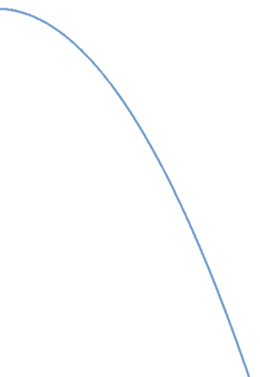









Second Order Effects
The dimer energy depends on the scattering length $E_{d}∝\frac{1}{a^{2}}$
The scattering length depends on the magnetic field $a→a_{(B)}$
This causes a shift in resonance DC magnetic field $Δ\overline{B}∝b^{2}$
$$E$$
$$Free atoms continuum$$
$$E$$
$$Free atoms continuum$$
$$\overline{B}$$
$$2b$$
$$\frac{1}{a}$$
$$2b$$
$$\frac{1}{a}$$
$$E_{d}∝\frac{1}{a^{2}}$$
$$E_{d}\sim \frac{1}{a^{2}}$$

Slide 21
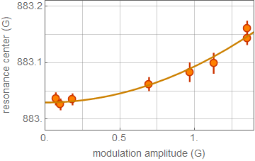
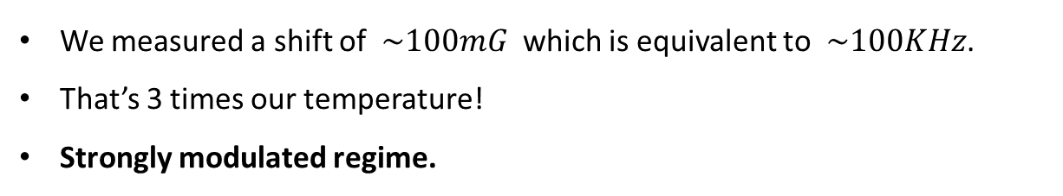
Second Order Effects
We measured a shift of $\sim 100mG$ which is equivalent to $\sim 100KHz$.
That’s 3 times our temperature!
Strongly modulated regime.
@ 4.6MHz

Slide 22
Conclusions
We’ve established to produce magnetic field RF pulses with:
Short pulse time.
High modulation amplitude – significant affect observed.
Elegant and simple solution.
This is a super efficient method for experiments that require high current passing through an inductor at high frequencies.

Slide 23

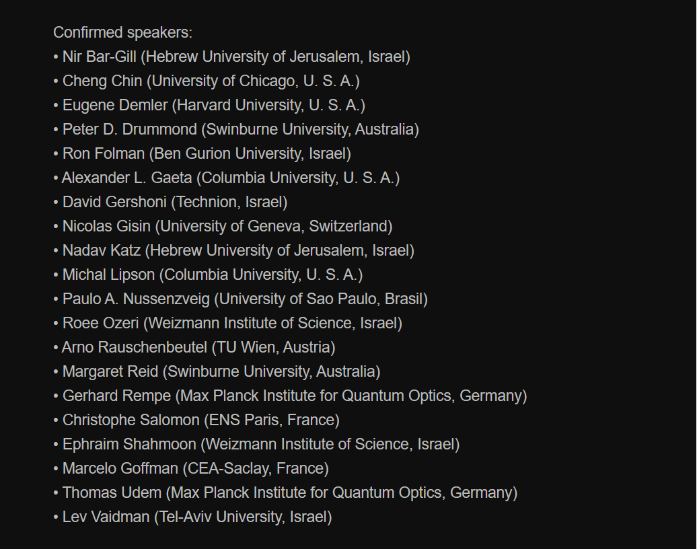
Registration at http://quest.biu.ac.il/quest2/
Best poster prize!

